Slide 1

Comprehensive Digital Marketing Project work
On Cadbury
By Bhuvaneswari Bhavana and team mambers:- Sahithi,Anusha,Arun and Harish.

Slide 2
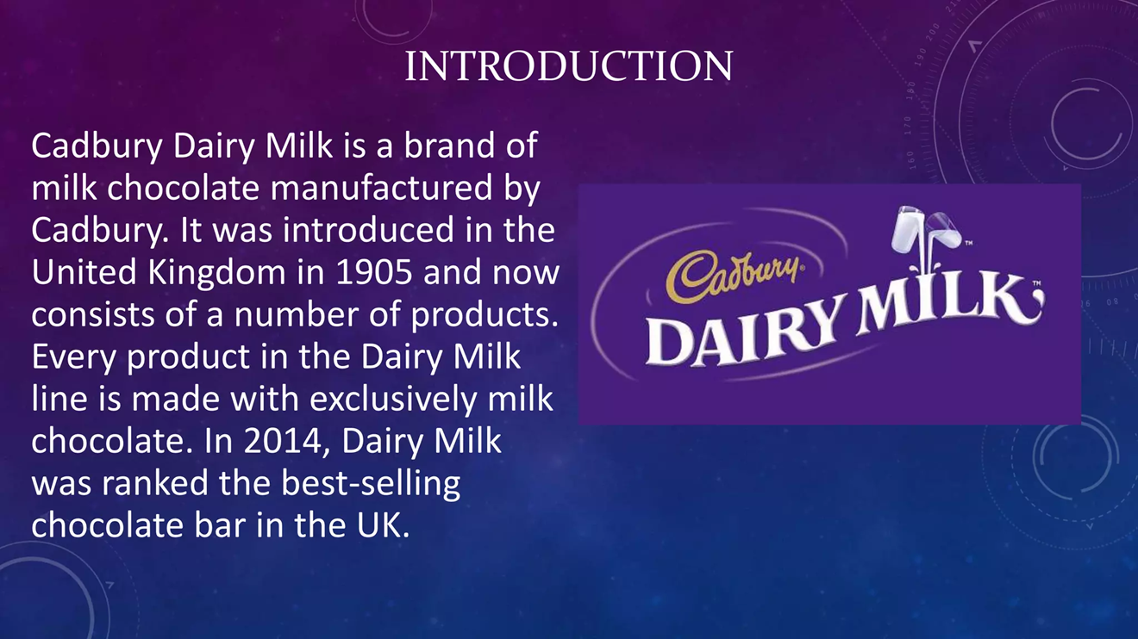

Slide 3

PART 1 :
BRAND STUDY:
(MISSION):
Cadbury, people always have been and will be, at the heart of everything we do”
provide customers with a high quality chocolate ranging from different milk choclates to a darker and white with a side of frits and nuts.Their main mission is to serve people with the richest quality of sweets that their heart desires.

Slide 4

VISION:
Cadbury, people always have been and will be, at the heart of everything we do”
Cadbury’s vision is to provide the people with every kind of choclate confectionaries in everyway possible to every occassion.
Cause they believe in you and your little successes and takes a part with our happiness through their confectionneries.

Slide 5

USP(Unique selling propositions):
Cadbury’s selling strategies executes their main theme of being a main part in celebrating our success.
They showed this by executing the right amounts and types of flavors and their rich choclates melts directly in our mouths and essesnce in the hearts.

Slide 6
VALUES:
Cadbury values the needs of their customers by giving them a great range of variety of combos for every little ocassiom which shows that they values our littlest of desires and wins.

Slide 7
Analyze Brand Messaging:
.Even after completion of more than 100 years, the brand leaves a significant mark amidst all the competition and still stands tall in food product sector. Cadbury is world’s leader in chocolates and it is also one of the topmost FMCG brands in India. On 21st April 2014, Cadbury India changed its name to Mondelez India Foods Private Limited.

Slide 8

Examine the brand's tagline:
‘” Taste like this feels”
'Kuch Accha Ho Jaaye, Kuch Meetha Ho Jaaye‘
The cadbury’s taglines varies based on the different types of choclate.
For Example:-
For 5-star:-it is "East 5-star, Do Nothing“.
For Bourneville it is 'You don't buy a Bournville, you earn it'

Slide 9

Part 1: Brand study, Competitor Analysis & Buyer’s/Audience’s Persona
Competitor 1: Kitkat is one of the lead selling choclates in the industry after Cadbury chocolates.These are made up of wafers and this choclate is made by Nestle
Competitor 2:Galaxy is also one of the branded choclates that is also getting bigger by the day and they are famous for their milk chocolates but they are quite on the pricey side with little quantity and their advertisments are hardly shown in the TV.
Competitor 3:Is the Hershey’s being a foreign brend hershey has also gained a good place in the list of choclates to keep in mind and even though there are many chocolate brands these has become main competitors to cadbury.

Slide 10
Buyer's/Audience's Persona
Choclates are evryone’s favorite and mostly to little kids.
Cadbury’s eyecatching asthetic is very dreamy and perfect to grab the customers eye and the taste sure does’nt dissapoint us and that is why it stood in the buyer’s hearts

Slide 11
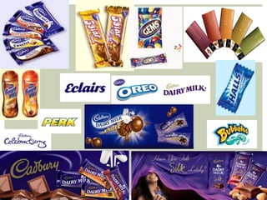

Slide 12
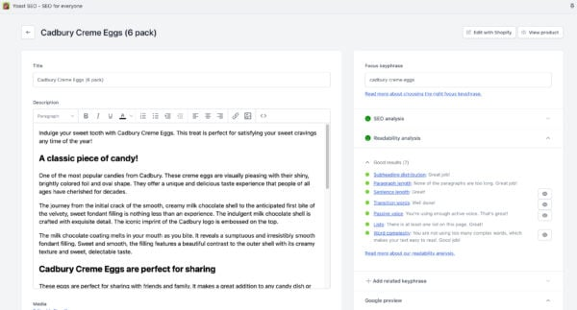

Slide 13
adbury’s Digital Marketing Strategies
1. Cadbury’s Social Media Marketing Strategies & Case Study
Cadbury entered the social media realm with the intent to revolutionize its marketing strategies and step back from Television and other traditional forms of advertising. Here is how they are currently performing on different social media platforms:
Cadbury’s Instagram Marketing Strategies
Cadbury has different Instagram accounts for each of its products. This allows them to keep their marketing more focused on that particular product and adhere to the audience consuming it. Each account has a different content, colour themes, and overall presentation.
Cadbury’s YouTube Marketing Strategies:
Unlike Instagram and Facebook, where Cadbury has different profiles for different products, Cadbury has only one channel on YouTube, with different sections for “Seasonal,” “Flavours,” and “Marvellous creations.” Cadbury has over 548K YouTube subscribers. They also use “YouTube Shorts,” YouTube’s most recent feature, to post short videos within 30 seconds.
Cadbury’s SEO Strategies
Cadbury India has a gifting website where people can customise their chocolates for gifting purposes and place an order for the same. According to SEMRush, here’s an overview of how their domain is performing:

Slide 14
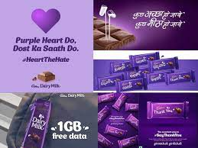
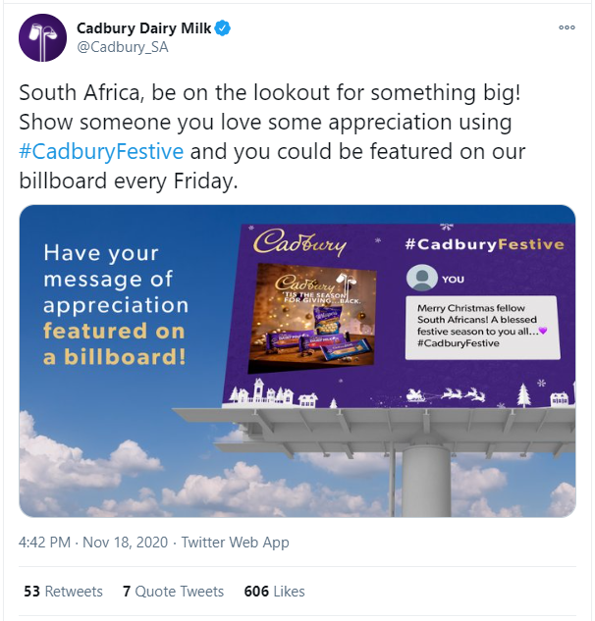

Slide 15


Slide 16
THANK YOU

